Slide 1


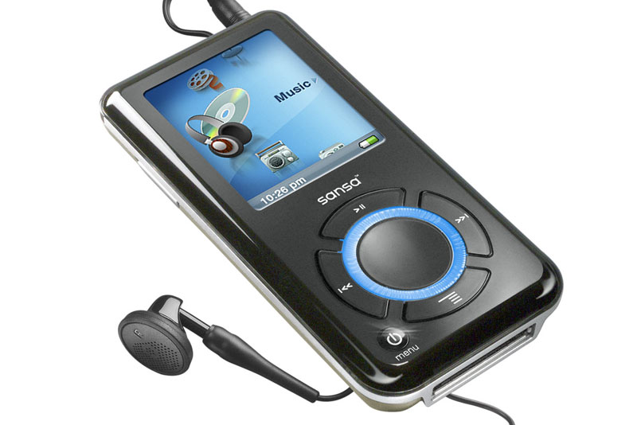




MP3 PLAYER
Here, we Are Making a Basic MP3 player using pygame, tkinter, mutagen, SQL in python language. Each and everything is explained in detail in comments, so must refer to it once. We were inspired to do this project as now-a-days people want to learn something new and from basic level, so to teach them we made this MP3 PLAYER.
Also, people will ENJOY Listening to music on MP3 PLAYER Made by themselves. It would also help them to relax from the hectic lifestyle of IIITB.
So, learn with fun and tell us if there's something to improve.

Slide 2
REFERENCES
https://www.studytonight.com/tkinter/music-player-application-using-tkinter
Build An MP3 Player With Tkinter pt1 - Python Tkinter GUI Tutorial #87
https://docs.python.org/3/library/tk.html
https://www.geeksforgeeks.org/python-playing-audio-file-in-pygame/
https://www.geeksforgeeks.org/python-gui-tkinter/
Intro-To-TKinter-Youtube-Course/player.py at master · flatplanet/Intro-To-TKinter-Youtube-Course (github.com)

Slide 3
System Requirements
Download source code
This project runs on windows
1) MYSQL
Download mysql
After following steps of installation go to mysql command line and write create database playlists. Now go to playlist.py and change the passwd in playlist.py . Set the passwd to the password you setup
2) TKINTER
Tkinter is installed while installing python
3) PYGAME
In cmd type copy-paste this pip install pygame
4) MUTAGEN
In cmd type copy-paste this pip install mutagen

Slide 4
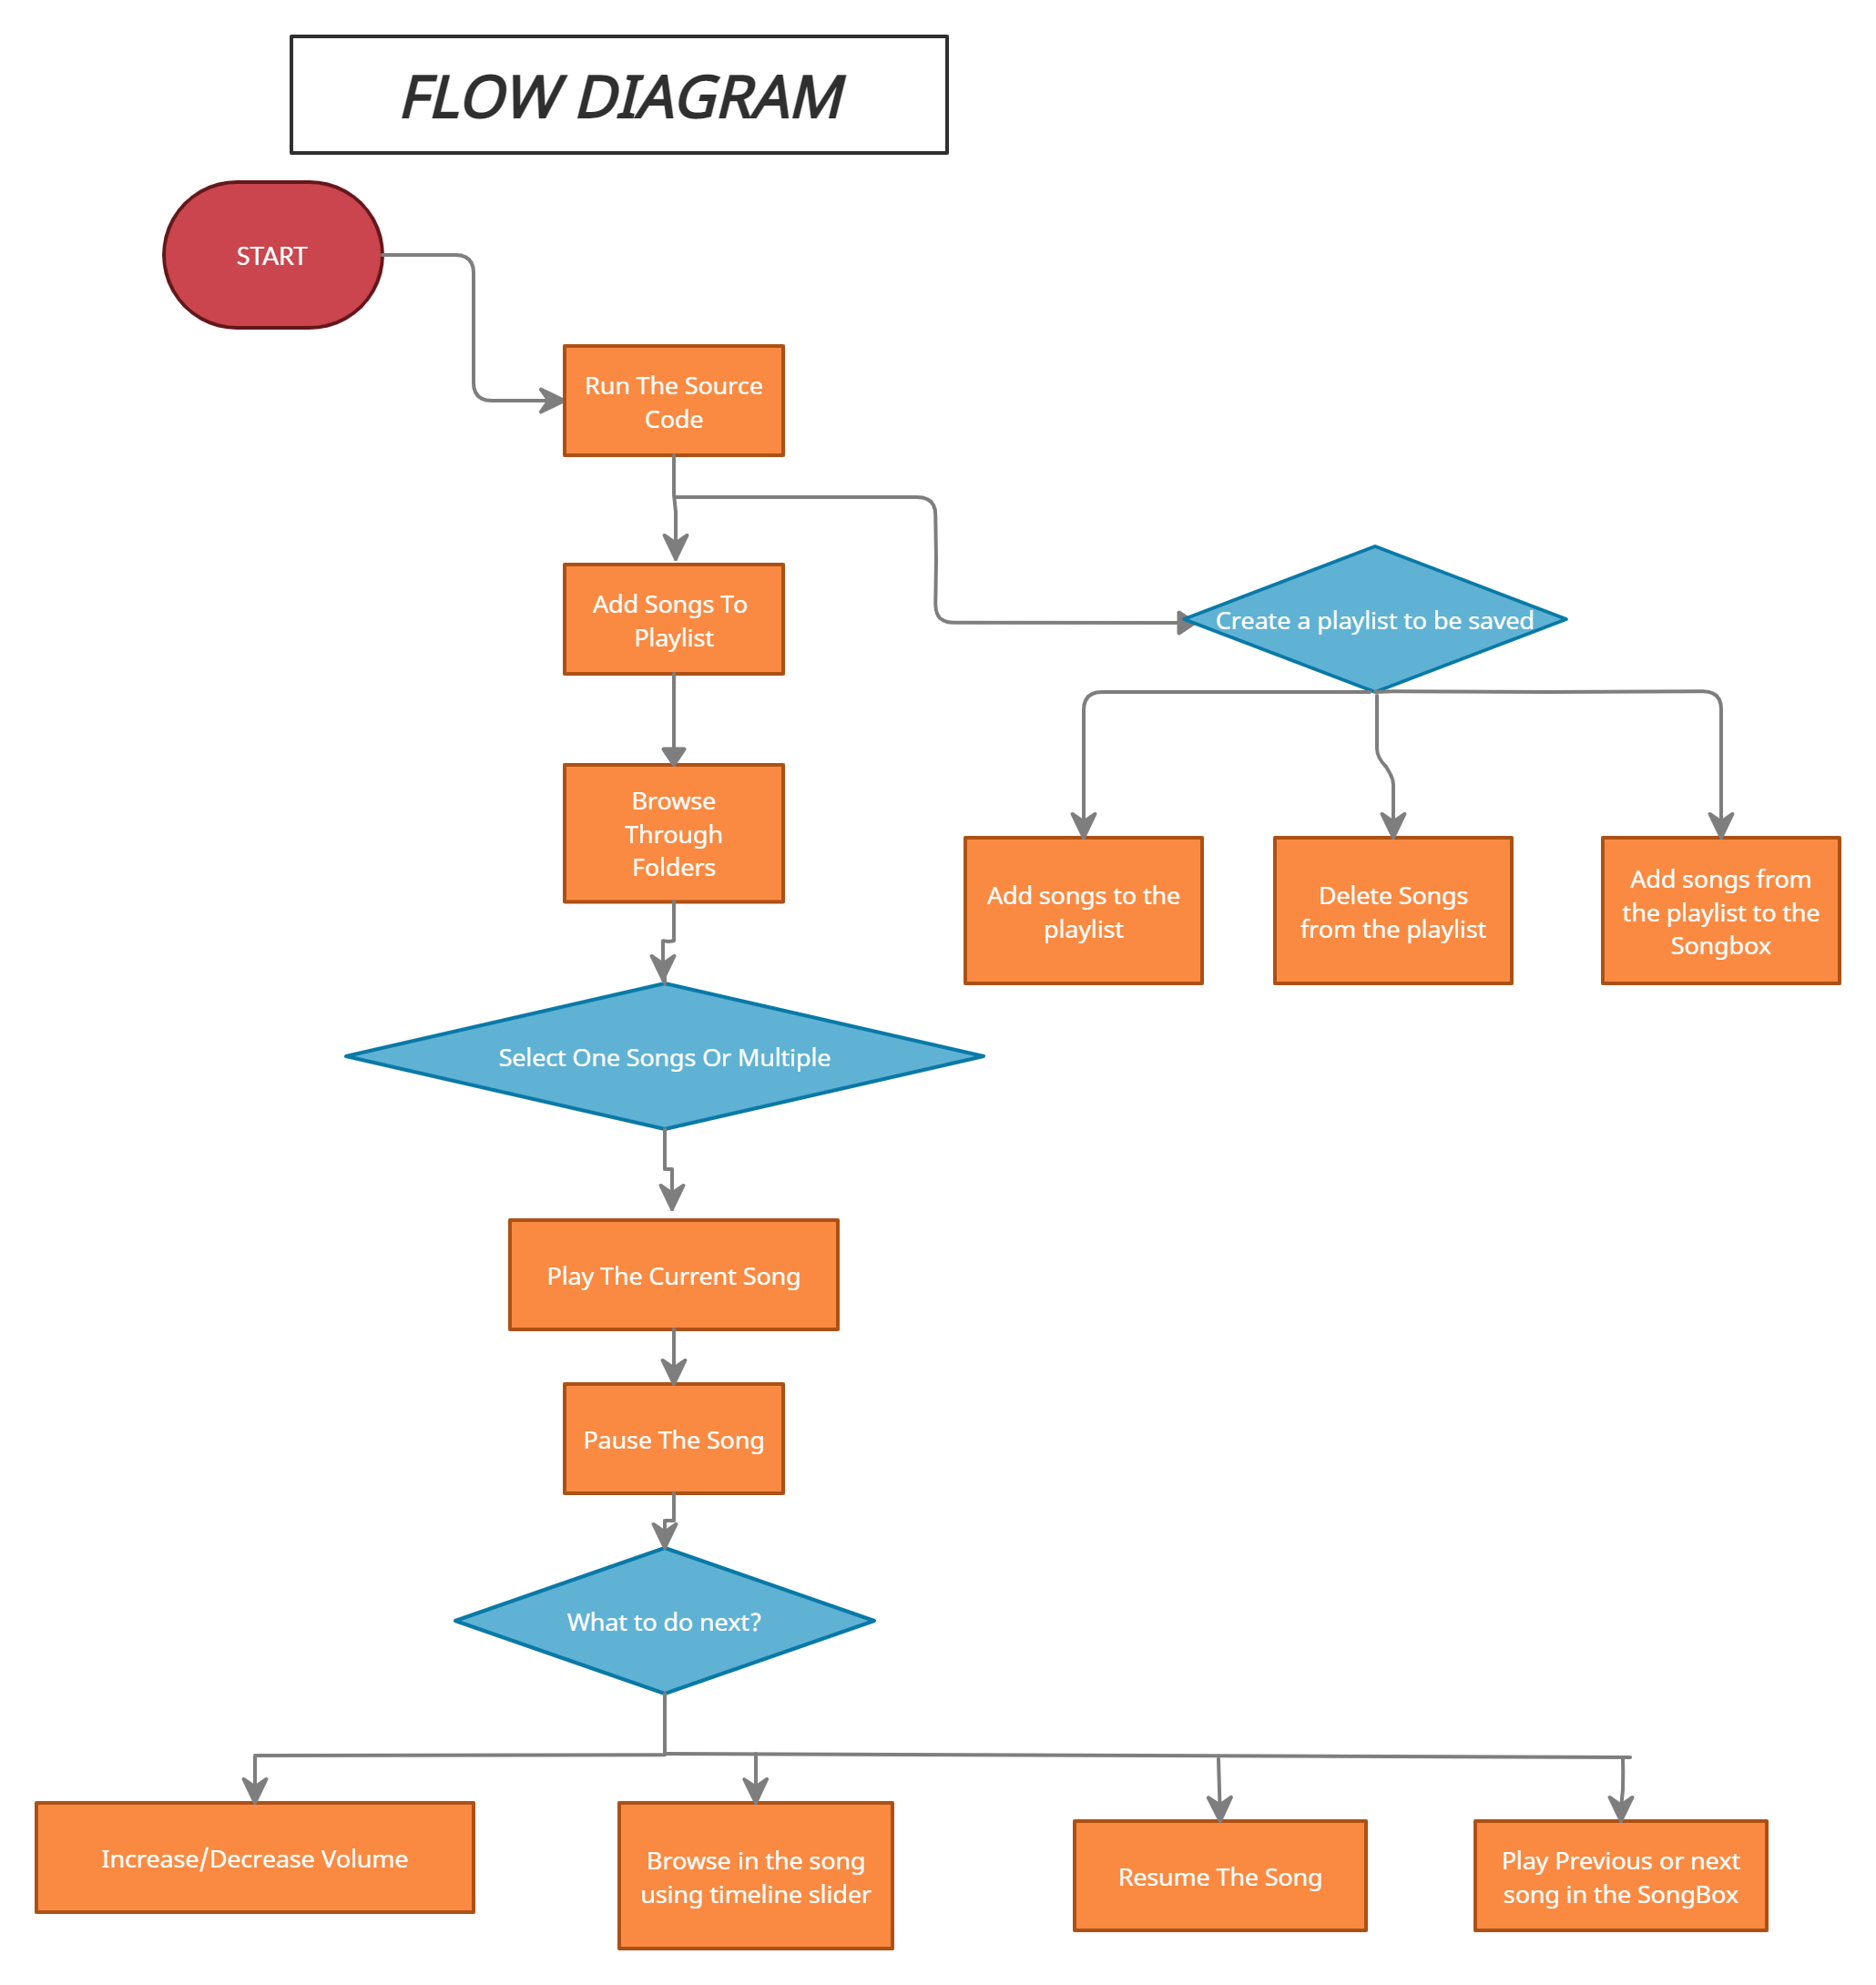

Slide 5
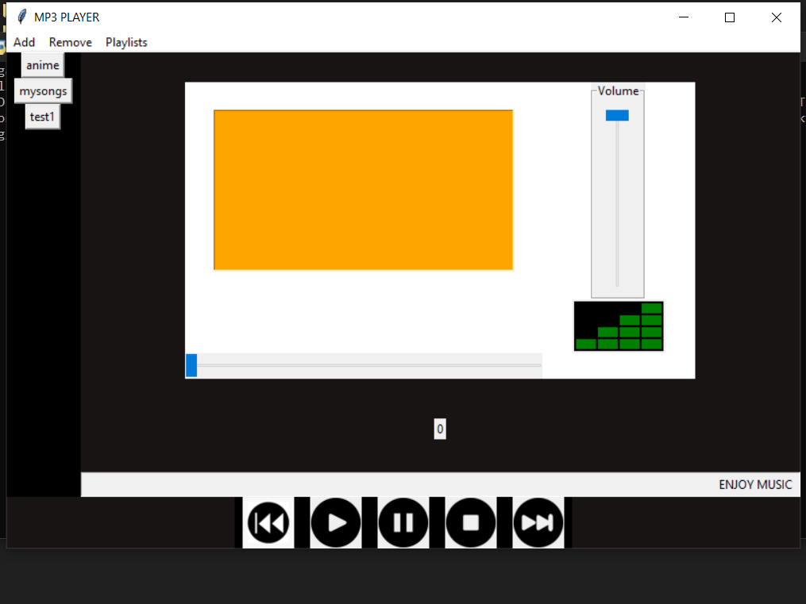
DEMONSTRATION

Slide 6
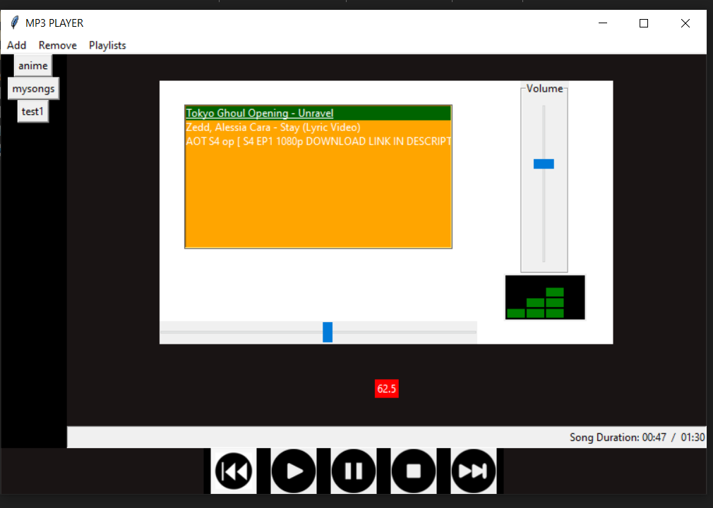
Demo Video:-Video Link(ctrl+click)

Slide 7
CONTRIBUTORS
HEET VASANI – IMT2020088
ARIN AWASTHI - IMT2020081
SHUBHANSHU AGRAWAL – IMT2020078
KARANVEER SINGH – IMT2020099
ARYA KONDAWAR - IMT2020084

Slide 8
FUTURE ASPECT
We can add an option to show LYRICS of the song being played at bottom by linking our MP3-Player online with websites that provides lyrics for songs.
We can also add the option to play any song by just searching in search bar and finding the song searched ONLINE or OFFLINE (if available) and Playing it.
We can also make an Option to ADD FAVOURITES.

